Slide 1


F
air for
E
merging
R
esearchers
Mentorship Session 5
Analyzing Your Data and Results

Slide 2
LET’S REVIEW THE SCIENTIFIC METHOD
1
OBSERVATION/
QUESTION
4
2
ANALYZE RESULTS
HYPOTHESIS
3
EXPERIMENT
Notes:
Goal: Review the scientific method with them. The slide is animated so that you might be able to engage the audience. This should be a quick review slide and we should hit on the fact that in order to have a good scientific experiment we need to follow this process.

Slide 3
What is the Scientific Method?
OBSERVATION/
QUESTION
4
What do your results mean?
Do your results support or reject your hypothesis?
What is the impact?
ANALYZE RESULTS
HYPOTHESIS
ANALYZE RESULTS
EXPERIMENT
Notes:
Goal: Want to address how we would analyze data. Things to address (1) Think about how your results relate to your original question (2) Hypotheses can do be proven but the results can support or reject your hypothesis (3) Think about the impact of the results and the limitations of your experiment and data. (4) Think about what do next (is there a better better guess, is there a cool next step)

Slide 4
What are we learning today????
We are learning how to analyze the data we collected from our experiments
Key Points to Consider:
1. Is my data reliable?
2. What conditions do my results apply to?
3. Are my results meaningful?
4. What is the best way to visualize/present my data?
Notes:
Goal: To hit the major goals for today.

Slide 5


Is my data reliable?
Data that is reliable must be reproducible, meaning you can get a similar result each time you do the experiment
Trustworthy measurement technique
Limited Confounding Variables

Slide 6


What conditions do my results apply to?
After getting a result we need to define the scope of impact, meaning we must figure out what situations to the results apply to
Identify limitations of the experiment
What situations did your experiment directly address
Notes:
Goal: To define a model systems. Model systems are all about taking a complicated system, and pulling out only the specific thing that we want to test. It makes things possible to study if they are:
Too dangerous: (studies of dangerous viruses may requires systems that are safer that will not infect others)
Too complicated: (Human disease is hard to study so we start studies in a much more simple system like a mouse)
Not possible: (it is impossible for us to study how earth formed but we can create environment that may mimic those conditions)

Slide 7
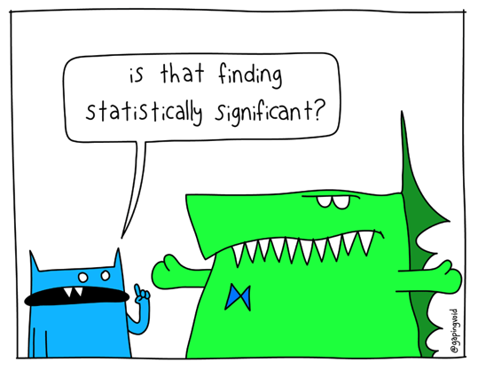

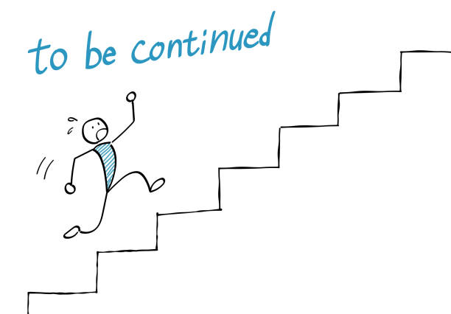
Are my results meaningful?
What do the results tell you about what is actually going on, AKA do the results answer your original question in a useful way
Are the results significant?
Does your data support your hypothesis?
What should you do next?

Slide 8
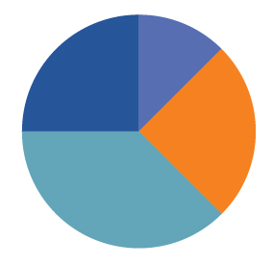
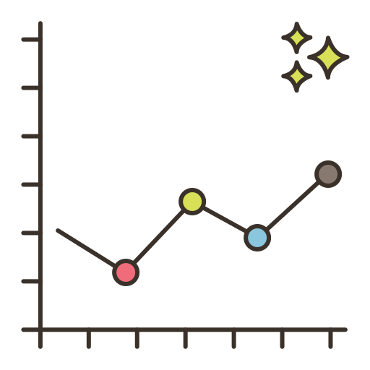
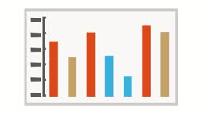

What is the best way to visualize/present my data
Depending on what you want to highlight about your results you may want to focus on a specific type of image to show your results.
DATA TABLE
To summarize all numbers from all conditions
PIE CHART
To show percentages of a whole
LINE GRAPH
To clearly show the relationship between two values
BAR GRAPH
To compare different conditions quickly

Slide 9
BREAKOUT SESSION TIME
GOAL 1: Icebreaker and introduce yourselves
GOAL 2: Work on analyzing your data
Notes:
Goal: Outline how breakout sessions will go. We should be 15 minutes into the session right now. Goal 1 should take about 5 minutes. Goal 2 should take 7 minutes. Goal 3 should take 18. We want to make sure they get to discuss project proposals with the mentors.

Slide 10
ICEBREAKER
Introduce yourself: say your name, grade, and school
Tell us what new thing you learned from your FER experiment
Notes:
Want a very quick ice breaker. We have been running long on these and want to make sure this finishes quickly.

Slide 11
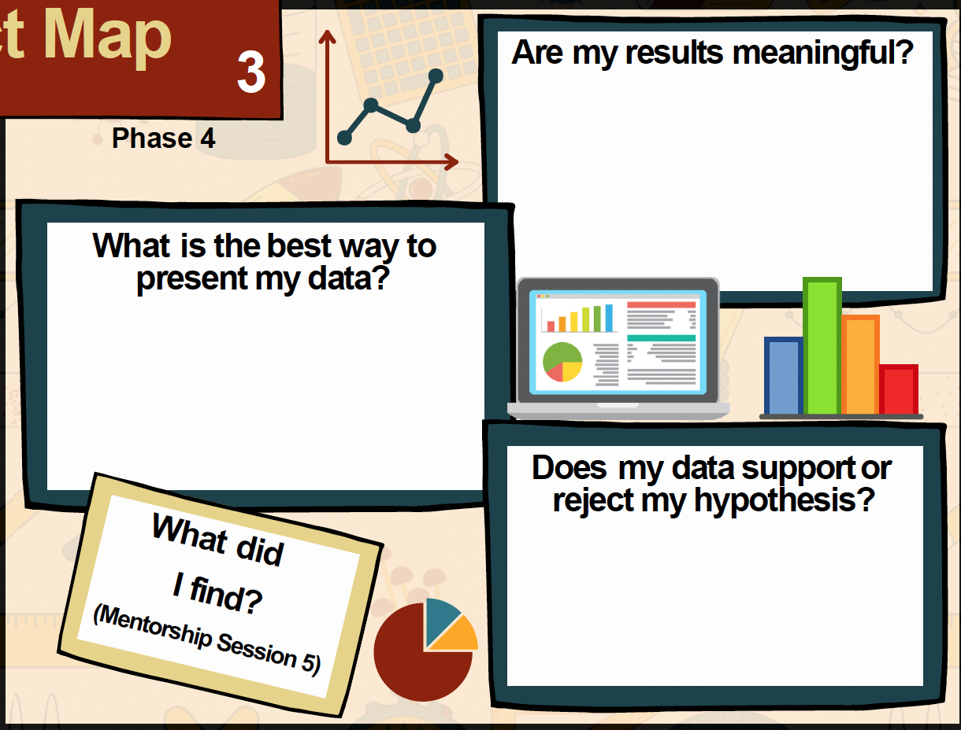
Let’s analyze your experiments
Notes:
Open graphic organizer online and make one for each student
https://drive.google.com/drive/folders/1VVcnpyCJDIEyMgK5A-mEYciYJETwI_WK?usp=drive_link
Tell them to refer to page 10 and 12 of the workbook for the homework answers

Slide 12
SHOW US SOME DATA!!!
CHECK OUT THE TUTORIALS TO MAKE OTHER FIGURES OF YOUR DATA
Notes:
Try to go through their figures or talk about their data with them. Try to give them advice on what they can do to improve their data and how they should present it.

Slide 13
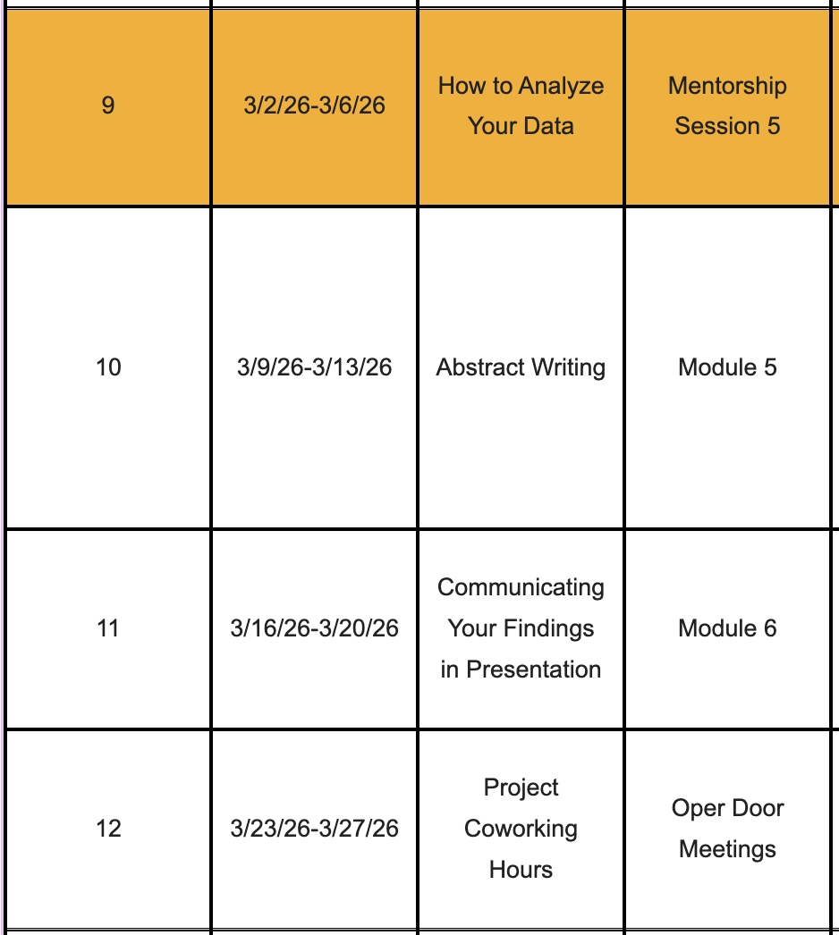
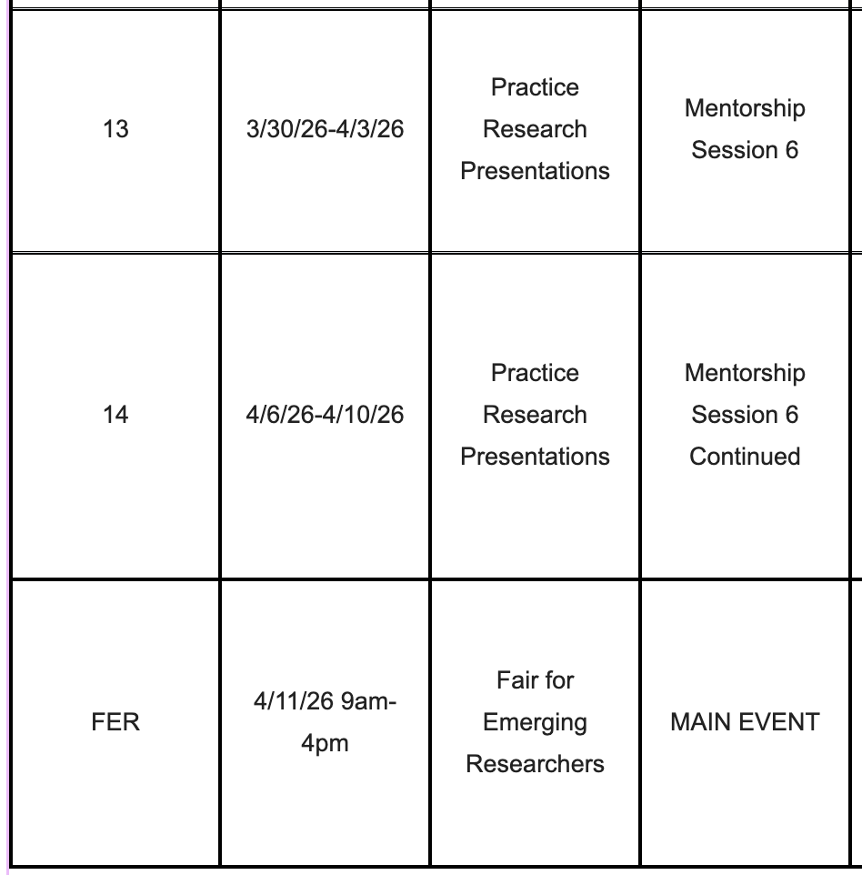
What’s Next??
Notes:
Goal: Remind them that next they will begin preparing for the FER. The next two modules they will be writing their abstracts and then creating their powerpoints. Abstracts are due for them to register for the FER. They are due for submission on our website by February 25th at 5 pm. At the next mentorship session they will get to practice their presentations with mentors.
Information and templates for the abstract and powerpoints will be posted.

Slide 14
Any Questions?
Contact Us
Organization Contact: mentorship.fer@gmail.com
Organization Website: scienceFER.org
Notes:
Remind them to check the website for more information about the next steps!

