Slide 1


F
air for
E
merging
R
esearchers
Mentorship Session 4
Designing Your Experiment

Slide 2
LET’S REVIEW THE SCIENTIFIC METHOD
1
OBSERVATION/
QUESTION
4
2
ANALYZE RESULTS
HYPOTHESIS
3
EXPERIMENT
Notes:
Goal: Review the scientific method with them. The slide is animated so that you might be able to engage the audience. This should be a quick review slide and we should hit on the fact that in order to have a good scientific experiment we need to follow this process.

Slide 3
What is the Scientific Method?
OBSERVATION/
QUESTION
A test to investigate our hypothesis
Use a controlled system that will give us data
ANALYZE RESULTS
HYPOTHESIS
3
EXPERIMENT
EXPERIMENT
Notes:
Goal: To remind them that they have now figured out their observation/question and they have a hypothesis to test. Now they need to design the experiment to test their hypothesis. They will want to remember that an experiment is specific to a hypothesis (use an example here, if you want to study sand color, you may need a different experiment to study why black sand forms or red sand forms). You also need to remind them that they need a controlled system. The controlled system will help them answer their specific question.

Slide 4
What are we learning today????
We are learning how to test our hypothesis using an experiment
Key Points to Consider:
1. What will be your model system and is it appropriate?
2. What will you use as your controls and variables?
Notes:
Goal: To hit the major goal for today. We want them to learn what a model system is and what variables are. These are the takeaways we want them to apply to their own experiments.

Slide 5



What is a model system?
A way to answer complicated questions that otherwise would be too difficult to answer using a simple model
Too Dangerous
Not possible
Too Complicated
Notes:
Goal: To define a model systems. Model systems are all about taking a complicated system, and pulling out only the specific thing that we want to test. It makes things possible to study if they are:
Too dangerous: (studies of dangerous viruses may requires systems that are safer that will not infect others)
Too complicated: (Human disease is hard to study so we start studies in a much more simple system like a mouse)
Not possible: (it is impossible for us to study how earth formed but we can create environment that may mimic those conditions)

Slide 6
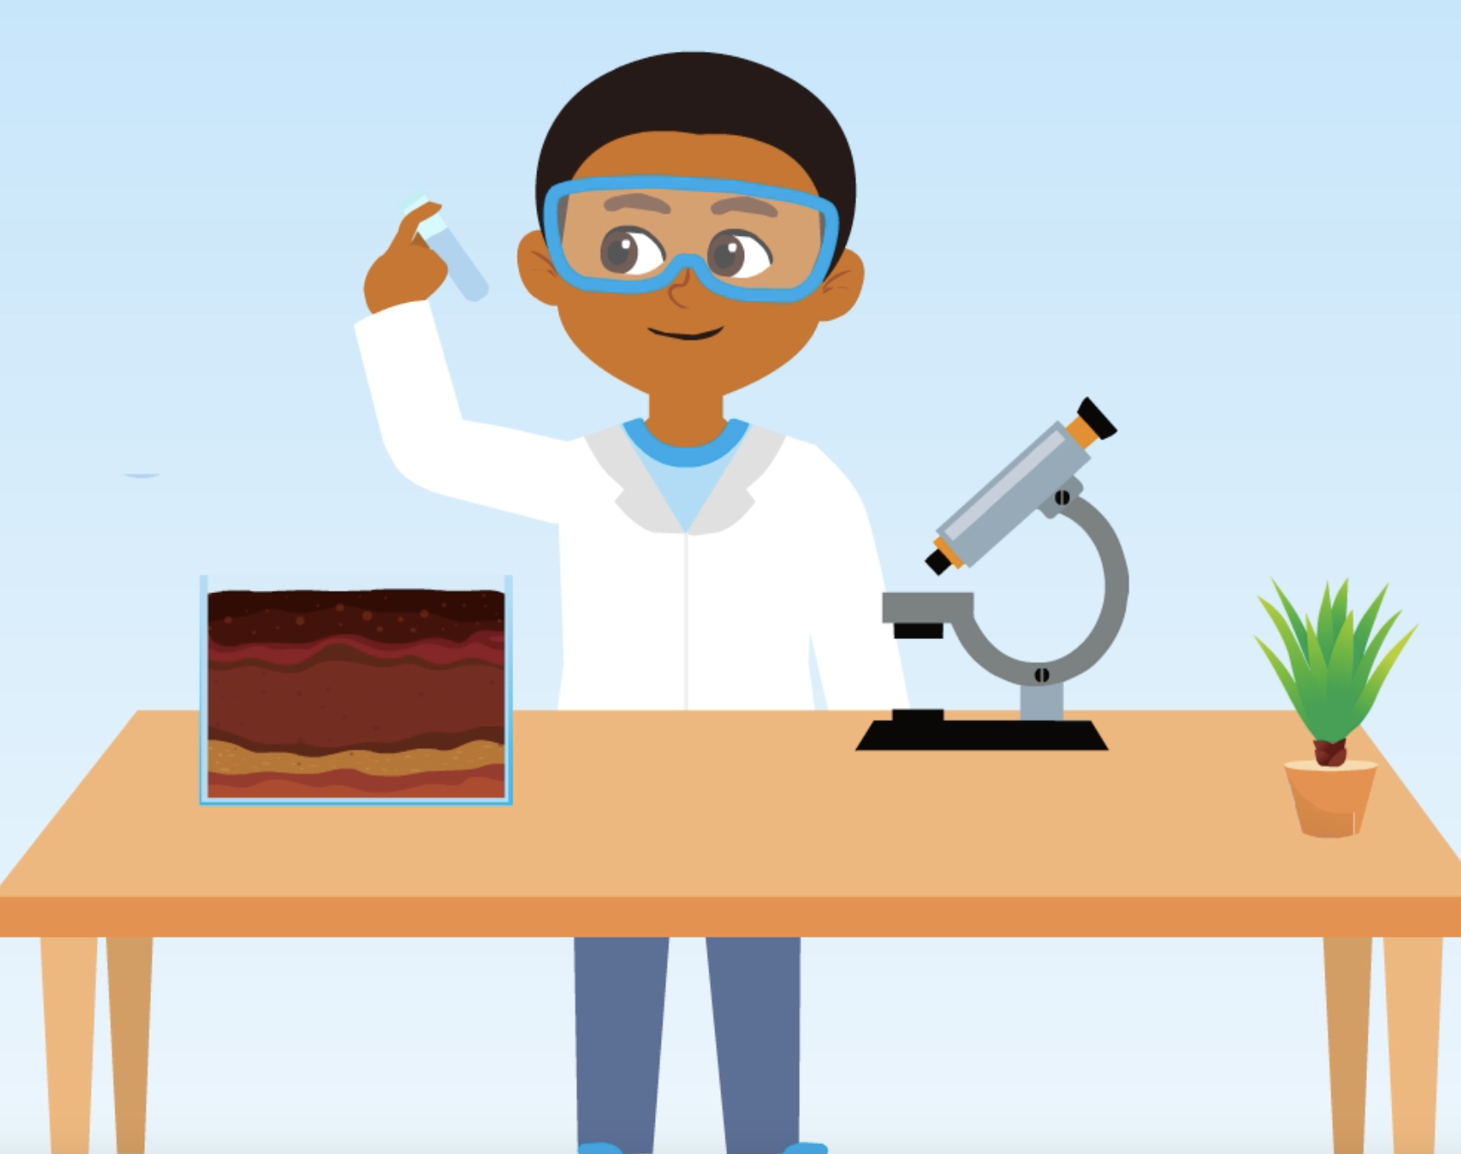
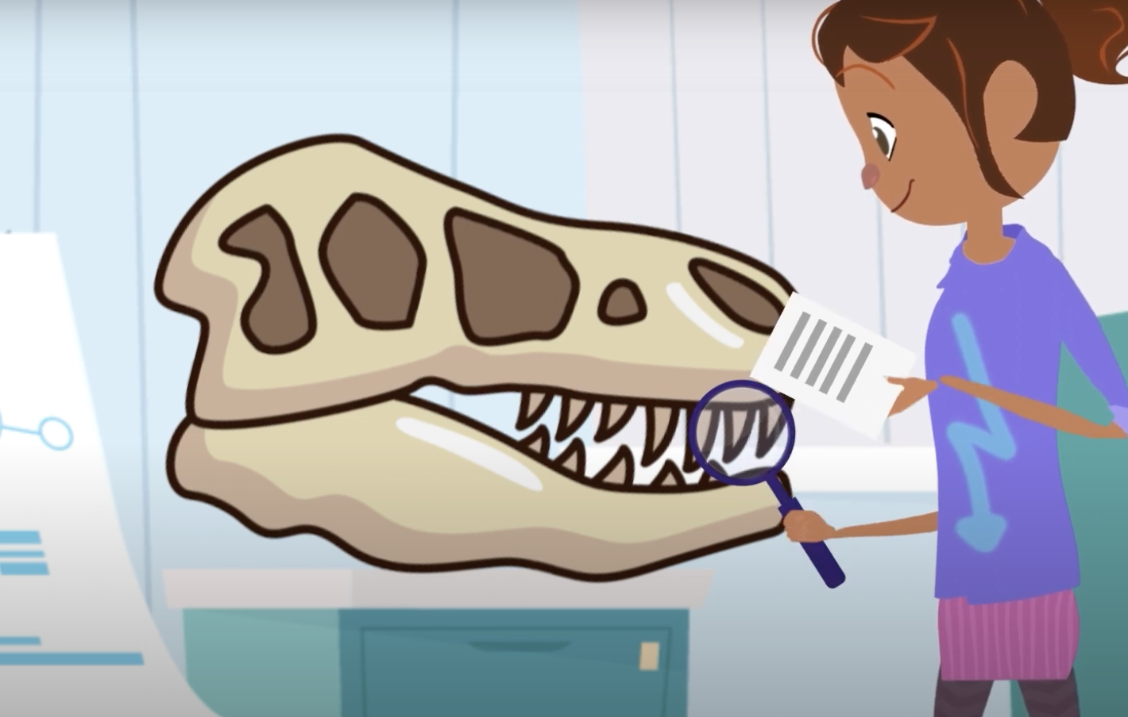
What did Gemma and Neville use for their model systems?
Gemma’s Model System
Neville’s Model System
Notes:
Goal: To help them review the modules and the concept of model system ask them what the model systems were for Gemma and Neville’s experiments, which are from modules they have done in the last two weeks. Good place to ask them to volunteer answers.
Gemma’s system: She wanted to figure out whether specific dinosaurs lived on earth or on land. Her model system is to study fossils because she can’t study the actual dinosaurs. She is measuring the amount of heavy oxygen in the teeth.
Neville’s system: He wanted to know if color effected how wormed burrowed in the soil. He made a box of dirt and put worms in that with different color lamps to study this.

Slide 7
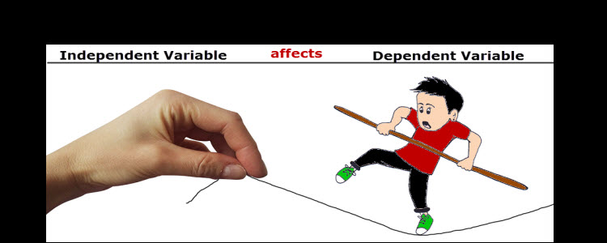
Variable Review
What conditions we change
What we measure
Notes:
Goal: Define independent and dependent variable. Independent variables are what we change (pulling the string). Dependent variables are the effects (whether the kid falls or stands straight).

Slide 8
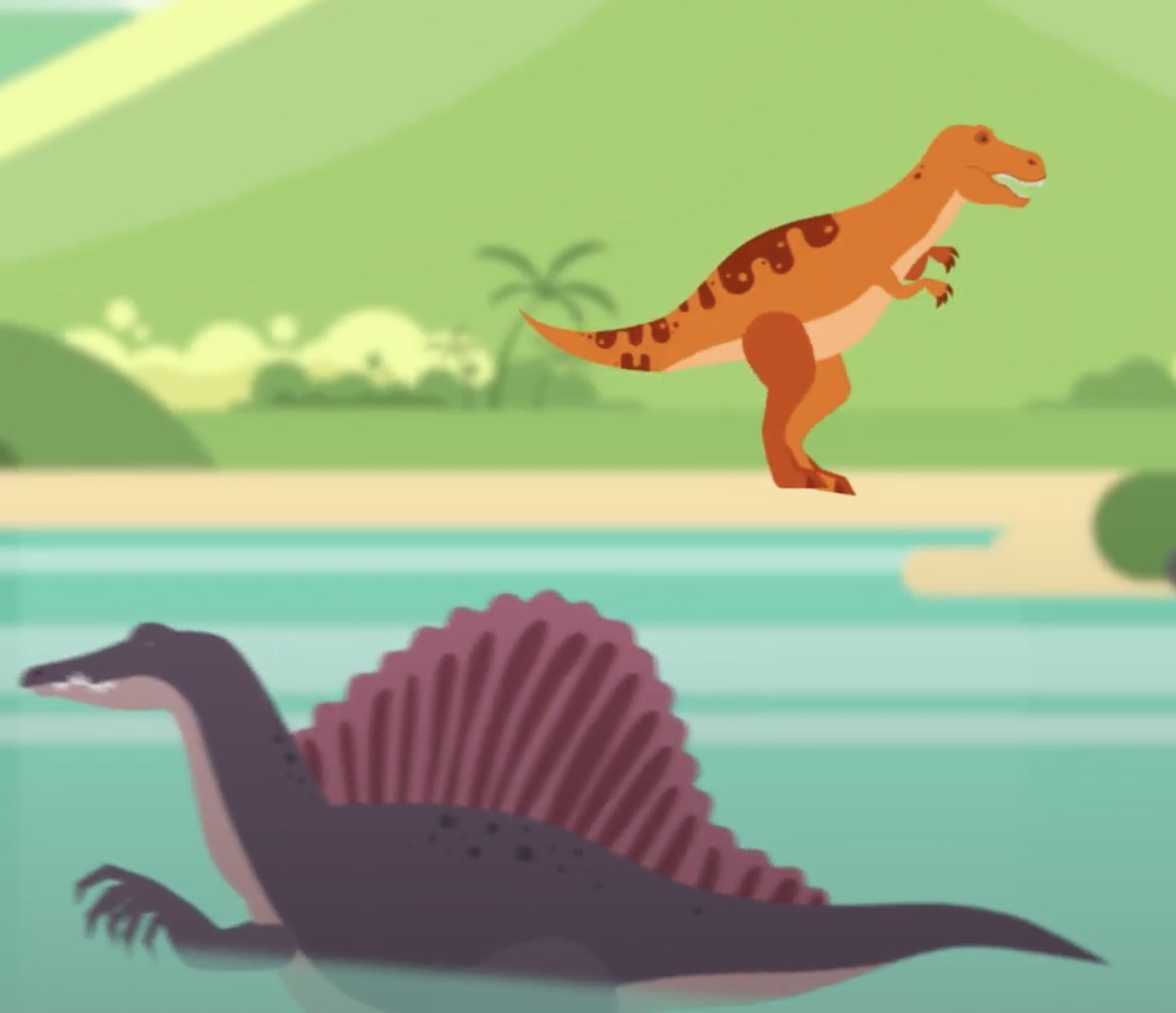
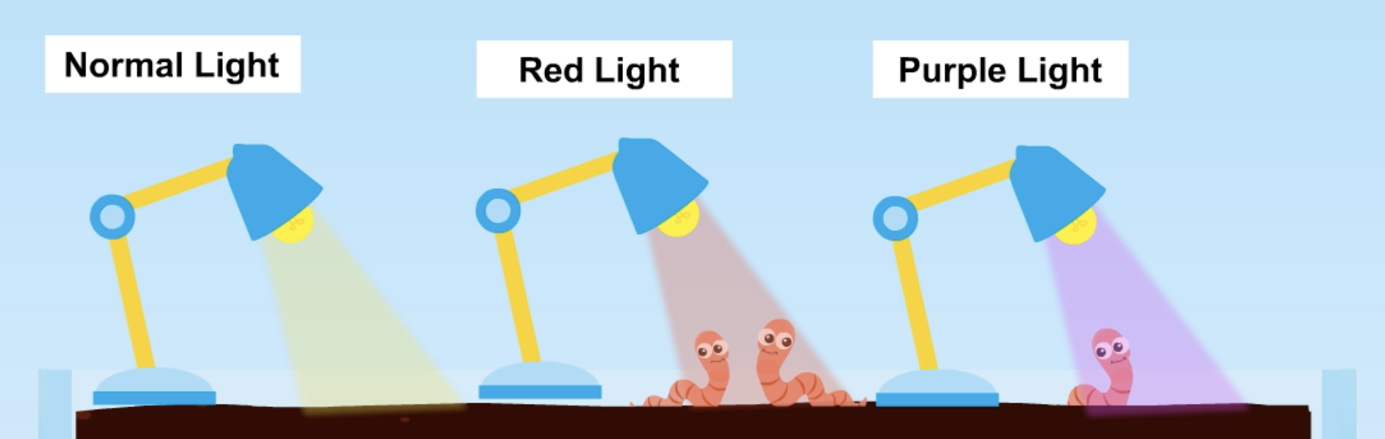
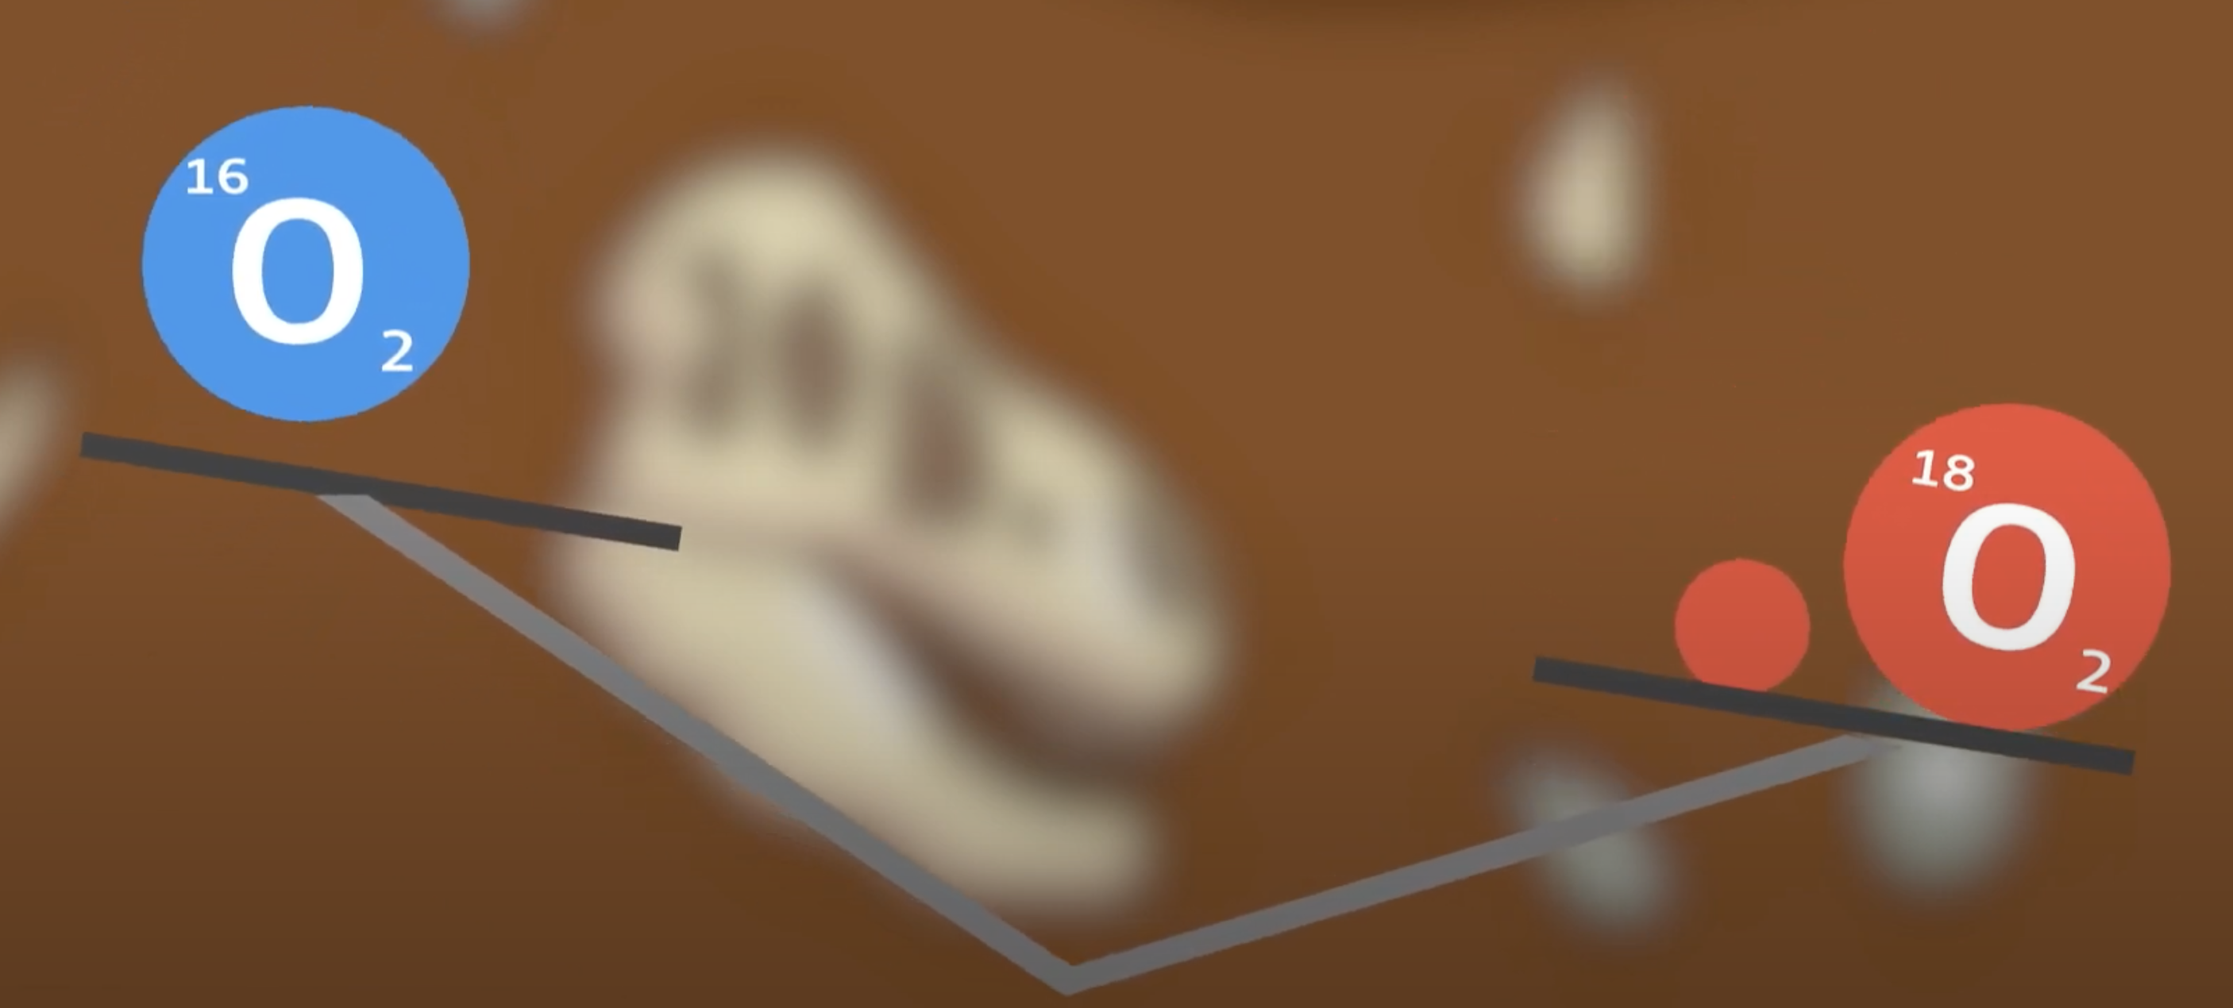
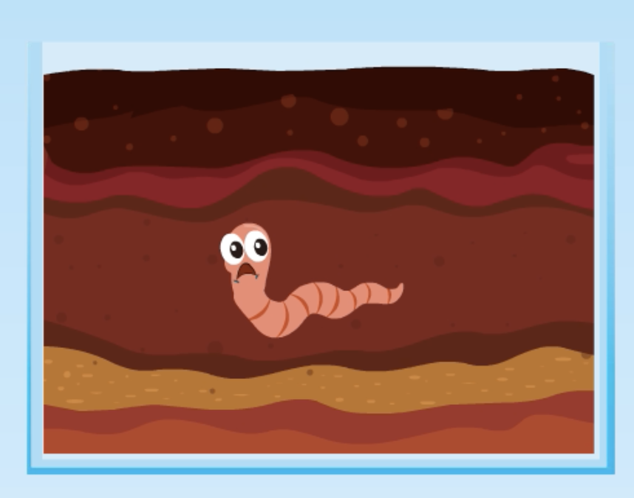
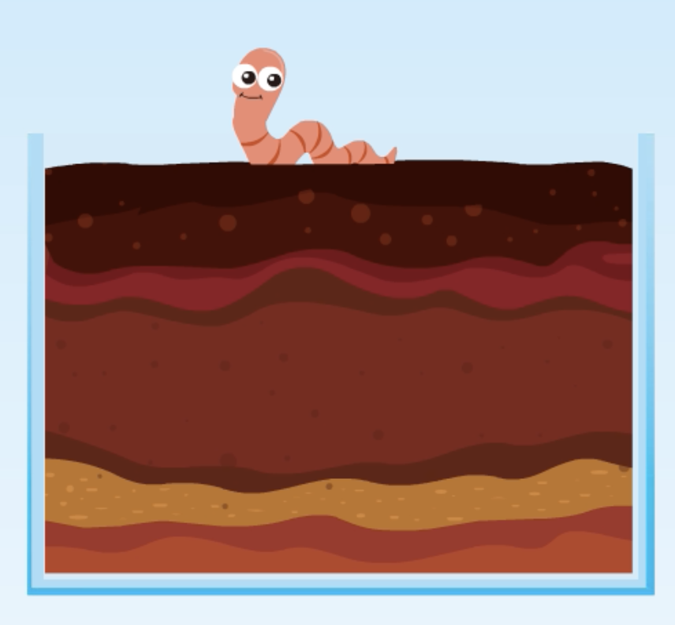
What did Gemma and Neville use for their variables?
Gemma’s Variables
Neville’s Variables
Type of Dinosaur
Light Color
Independent
Amount of Heavy Oxygen
Amount of worms that burrow
Dependent
Notes:
Goal: To review with them the variables from the modules. The slide is animated so you can ask them to volunteer answers.

Slide 9
BREAKOUT SESSION TIME
GOAL 1: Icebreaker and introduce yourselves
GOAL 2: Conduct an activity with your mentors to review the concepts we just learned
GOAL 3: Work on designing your own experiment
Notes:
Goal: Outline how breakout sessions will go. We should be 15 minutes into the session right now. Goal 1 should take about 5 minutes. Goal 2 should take 7 minutes. Goal 3 should take 18. We want to make sure they get to discuss project proposals with the mentors.

Slide 10
ICEBREAKER
Introduce yourself: say your name and grade
Our activity today will involve a unique job, tell us your dream “fun” job that you would want to do when you grow up
Notes:
Want a very quick ice breaker. We have been running long on these and want to make sure this finishes quickly.

Slide 11


Review Activity
If I dropped a feather and a hammer of the same weight on the moon which would hit the ground first?
What will be your experimental set up?
AKA what data will you collect
Notes:
Goal: Ask them to make a design of the experiment. Essentially get them to say they want to drop both at the same time and measure with a stopwatch.

Slide 12
Review Activity
What would the independent variable be?
What would the dependent variable be?
What would be a possible confounding variable?
Notes:
Goal: Apply the lesson to this activity.
Independent variable is the object
Dependent: time to fall to ground
Confounding: position dropped from need to be exactly the same.

Slide 13
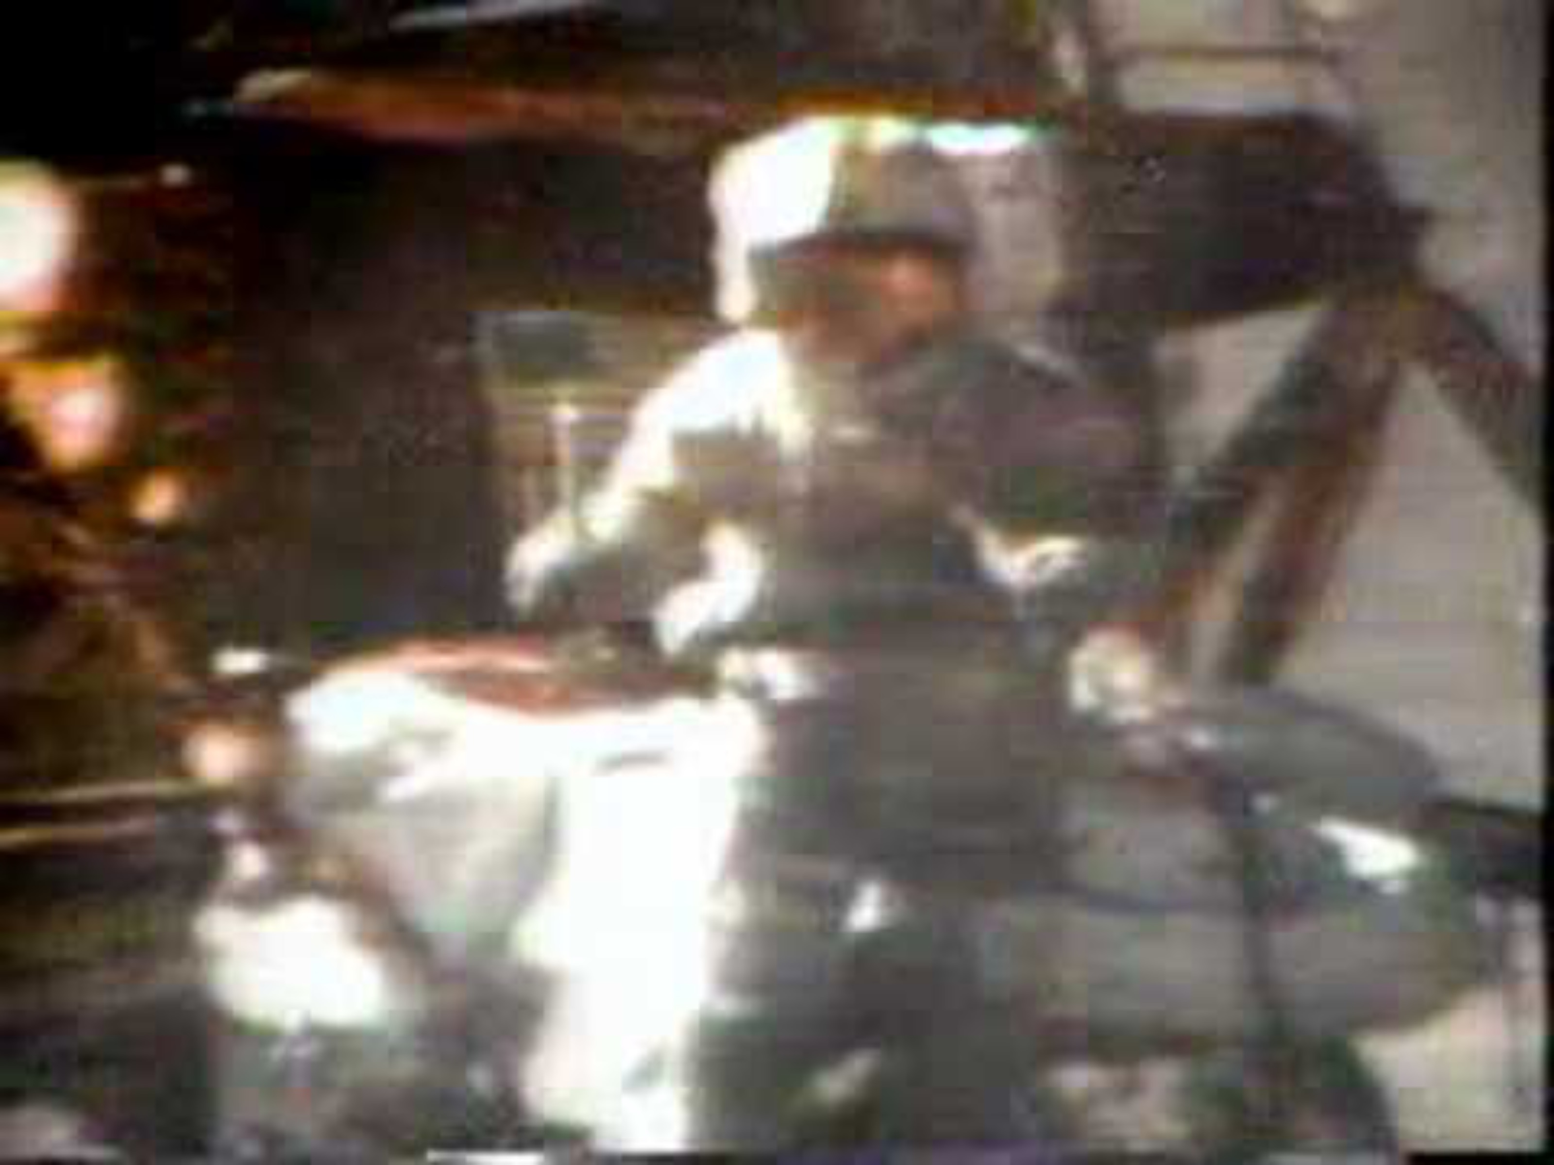
Let’s do the experiment on the moon!!!
Notes:
Goal: Have them guess which one falls faster (make them vote for one or the other). Obviously they fall at same rate but it fun from them to have teams. Unless someone is too clever.
Link if you cannot access it:
https://www.youtube.com/watch?v=GdHlWp9k_sY

Slide 14
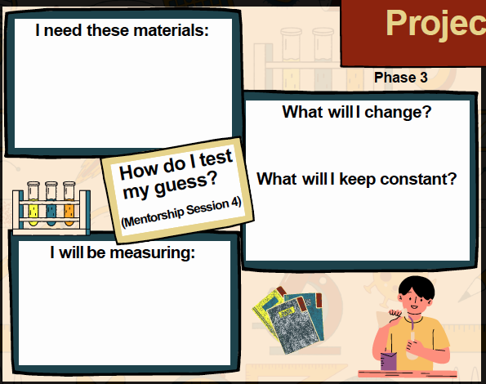
Let’s work through your project map
(Phase 3) Open Page 3 of your Workbook
Notes:
Open graphic organizer online and make one for each student
https://drive.google.com/drive/folders/1VVcnpyCJDIEyMgK5A-mEYciYJETwI_WK?usp=drive_link
Tell them to refer to page 10 and 12 of the workbook for the homework answers

Slide 15
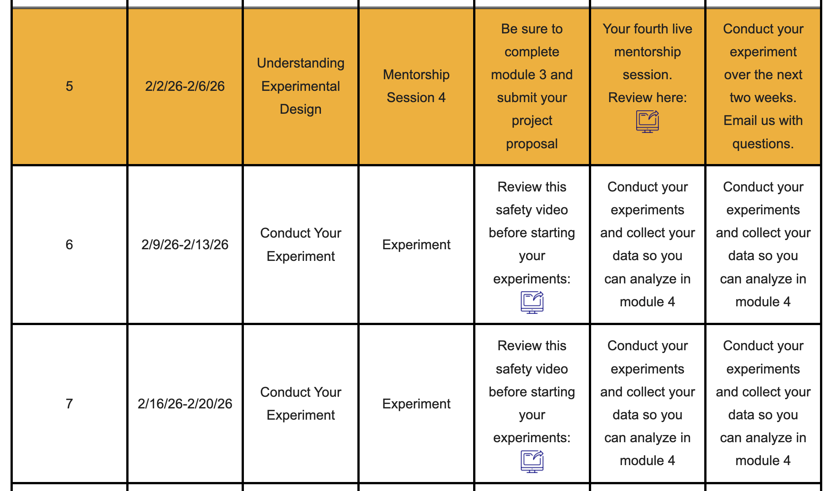
What’s Next??
https://sciencefer.org/student_resources/
Notes:
Goal: Remind them that next they will do their experiments. Then they will analyze their data.

Slide 16
Any Questions?
Contact Us
Organization Contact: mentorship.fer@gmail.com
Organization Website: scienceFER.org
Notes:
Remind them to check the website for more information about the next steps!

