Slide 1


F
air for
E
merging
R
esearchers
Mentorship Session 3
Crafting Your Hypothesis

Slide 2
LET’S REVIEW THE SCIENTIFIC METHOD
1
OBSERVATION/
QUESTION
4
2
ANALYZE RESULTS
HYPOTHESIS
3
EXPERIMENT
Notes:
Goal: Review the scientific method with them. The slide is animated so that you might be able to engage the audience. This should be a quick review slide and we should hit on the fact that in order to have a good scientific experiment we need to follow this process.

Slide 3
What is the Scientific Method?
OBSERVATION/
QUESTION
An educated, testable guess to answer your question
2
HYPOTHESIS
ANALYZE RESULTS
HYPOTHESIS
EXPERIMENT
Notes:
Goal: A hypothesis is a guess that is a specific proposed answer to the scientific question. Characteristics that should be stressed: (1) they must be testable (2) must come from background research (3) can be an if then statement. May use examples to hit at what this is.

Slide 4
WHAT ARE WE LEARNING TODAY????
WE ARE LEARNING HOW TO DEVELOP OUR HYPOTHESIS
STEP 1: HAVE A SPECIFIC QUESTION
STEP 2: DEVELOP A EDUCATED GUESS THAT CAN BE TESTED
Notes:
Goal: To hit the major goal for today. We want them to be able to the question that are interested in and turn that into a hypothesis that they can use for their experiments

Slide 5



CONCEPT REVIEW
What makes a good hypothesis? What are the rules?
Needs to be educated from thorough background research
Needs to be addressing a very specific idea or topic
Needs to be testable using an experiment
Notes:
Goal: Address the key parts to a good hypothesis.
Hypothesis need to be educated. They now know how to do background research so this is covered.
Hypothesis needs to be specific. Narrow down the exact thing you want to study (Ex: type of animal, rock, environment, object, or any other science thing you are studying), Identify and set limits on the situation you wish to study (Ex: Time of day, location, temperature, etc.), Include the result expected from the “If” statement (Ex: will grow taller, will live longer, will be closer to a volcano, etc.)
Hypothesis needs to be testable. Needs to be a real thing (Ex: Can’t study unicorns, the “Force” from Star Wars, etc.), Needs to be a location you can get to (Ex: Can’t be an experiment on the moon, in the depths of the ocean, inside a volcano, etc.), Needs to be something that can be controlled in an experiment (Ex: Cannot create or change hurricanes, diseases, planets, etc), Needs to be accessible and not too large in scale: (Ex: Cannot do an experiment on the entire ocean, entire city, working with antigravity, etc)

Slide 6
HOW DO YOU WRITE A HYPOTHESIS
A HYPOTHESIS HAS TWO PARTS
PART 1: IF STATEMENT→ what is the specific observation you are interested in
PART 2: THEN STATEMENT→ what is your guess as to what causes the observation to happen
If _________________, then ________________.
Notes:
Goal: Hypotheses have a specific format. We need an If and a then. If is addressing the specific observation. Then is addressing the guessed reason you think the observation happens.

Slide 7
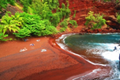
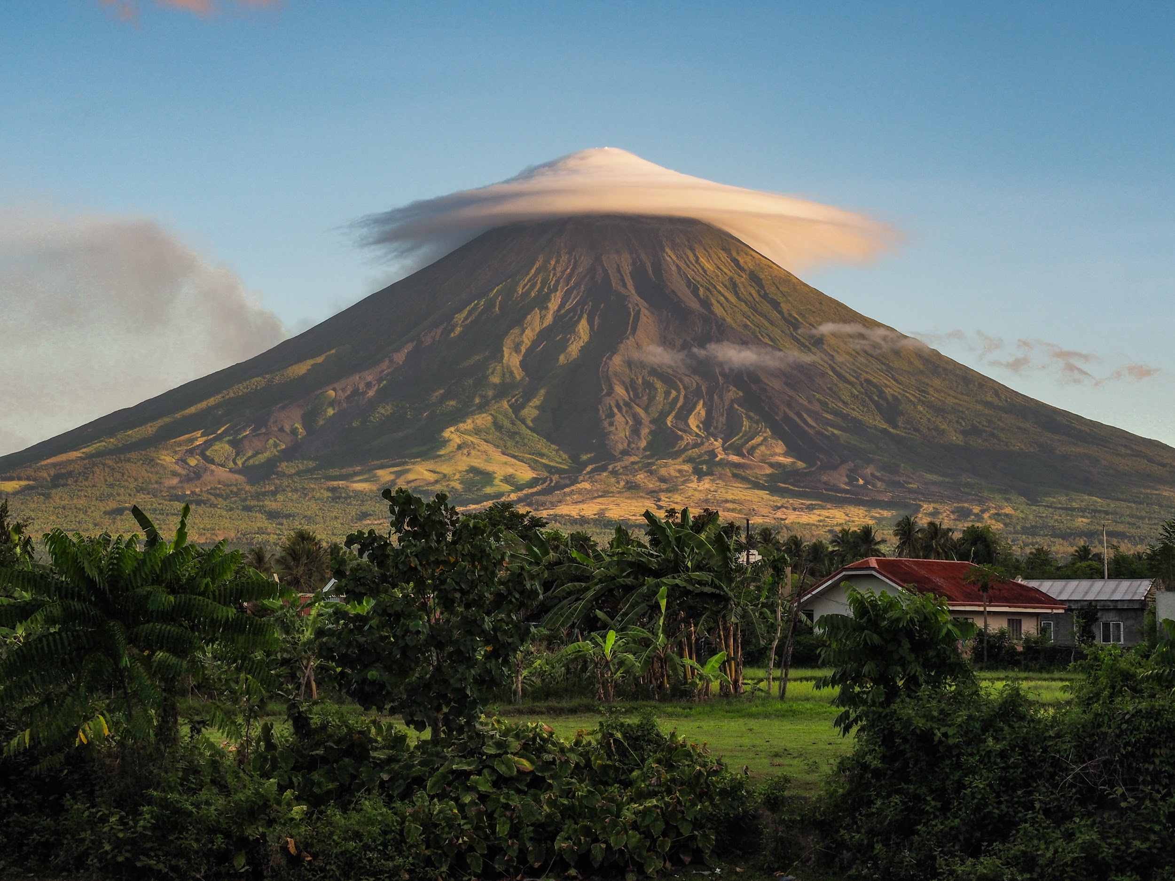
WHAT WAS GEMMA’S HYPOTHESIS
If a beach has red sand, then it will be closer to a volcano.
Notes:
Goal: Remind them gemme’s hypothesis from the module.

Slide 8
BREAKOUT SESSION TIME LET’S APPLY IT TO YOUR PROJECT
GOAL 1: Icebreaker and Introduce Yourselves
GOAL 2: Conduct an activity with your mentors to review the concepts we just learned
GOAL 3: Work on your hypothesis (Open page 8 of your workbook)
Notes:
Goal: Outline how breakout sessions will go. We should be 15 minutes into the session right now. Goal 1 should take about 5 minutes. Goal 2 should take 10 minutes. Goal 3 should take 15. We want to make sure they get to discuss project ideas with the mentors. They should be leaving with good hypothesis.

Slide 9
ICEBREAKER:
STEP 1: Say your name and grade
STEP 2: Tell us your favorite exotic animal you would want as a pet
Notes:
Goal: Get them comfortable talking with you. Have each student go around. They will do step 1, 2. Then the mentor should randomly call on someone to make a guess on the person speaking.

Slide 10
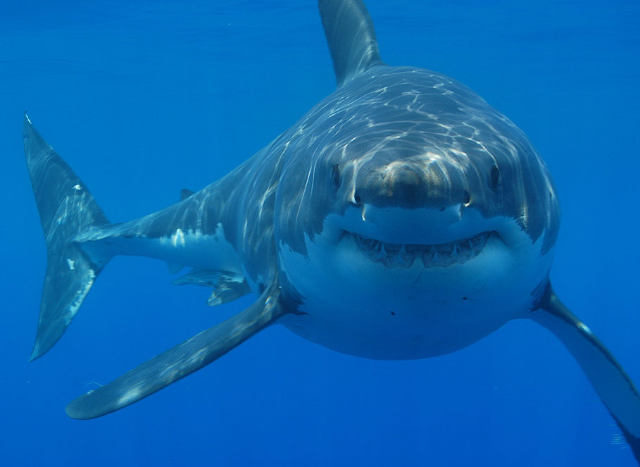
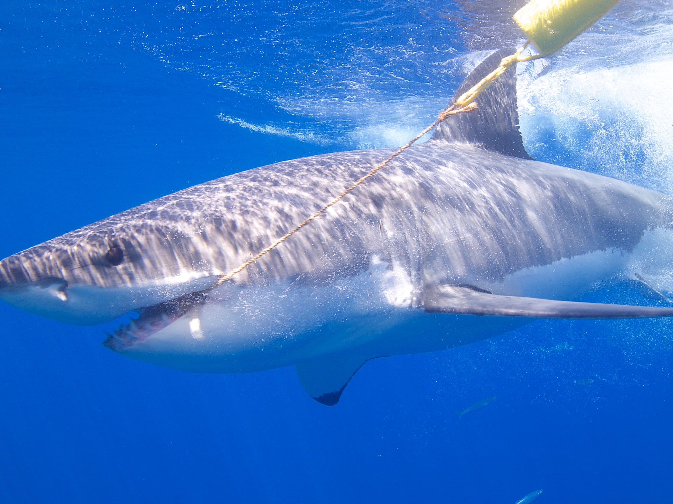
Activity 1 Let’s Practice Making a Hypothesis
Lets construct a hypothesis based on the following observation
Observation: The shark on the left is bigger than the shark on the right.
Notes:
Goal: Talk them through this experimental story. Get them talk. Make them make guess as to why the two sharks are different sizes.

Slide 11

OUR BACKGROUND RESEARCH
We already know that animals and people grow throughout their lives
Human adults are larger than human children
Sharks grow from 5 feet up to 20 feet during their lives
OUR QUESTION: DO SIZE AND AGE CORRELATE IN SHARKS?
Notes:
Goal: Transition them to focus in on age as a reason for determining size.

Slide 12
WHAT IS OUR HYPOTHESIS
IF STATEMENT?
THEN STATEMENT?
IF A SHARK IS BIGGER THAN ANOTHER SHARK, THEN THAT SHARK IS OLDER IN AGE.
Notes:
Goal: Get them to write out hypotheses and put it in the chat. Make sure they give it to you in If then format.

Slide 13
OUR RESULTS
17 feet, 3,700 pounds, 15 years old female
13 feet, 2,800 pounds, 22 years old male
Notes:
Goal: Highlight that it is okay that a hypothesis is wrong!
Here you can tell them in this case it is because they are different genders of Great White sharks and that leads to them having different sizes, but it could also be other factors. If you have time you can have them guess reasons first.

Slide 14
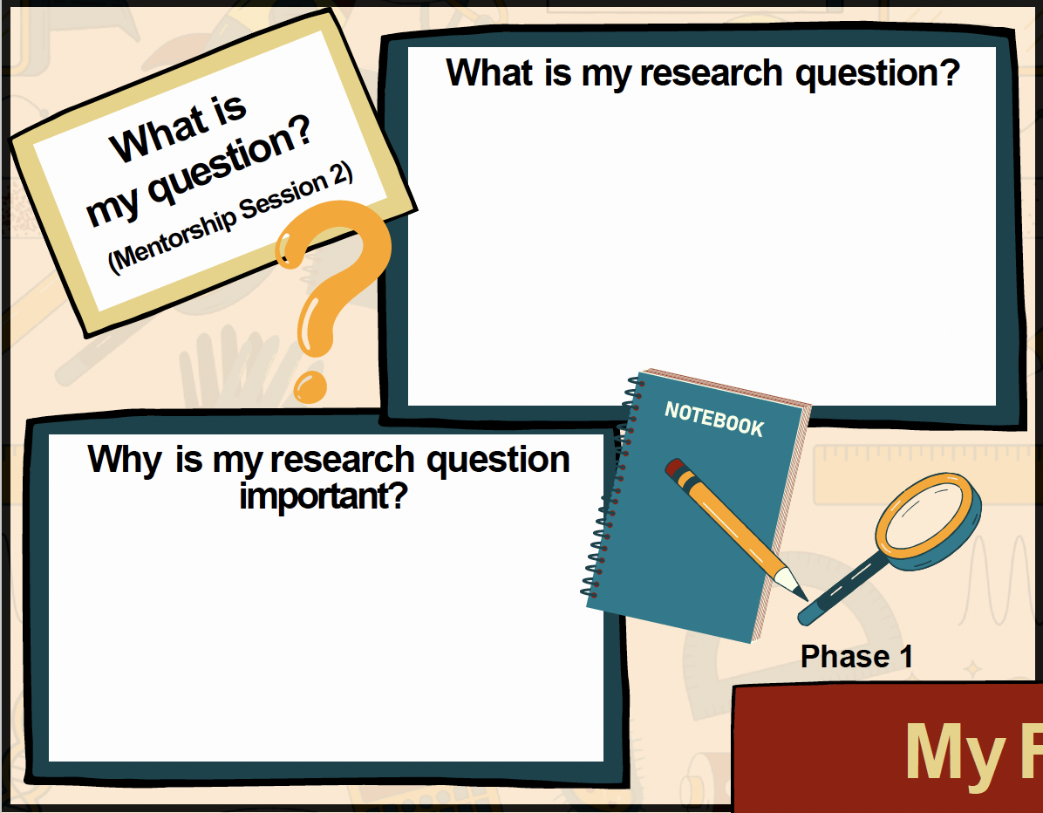
Let’s work through your project map (Phase 1) Open Page 1 of your Workbook
Notes:
Open graphic organizer online and make one for each student
https://drive.google.com/drive/folders/1VVcnpyCJDIEyMgK5A-mEYciYJETwI_WK?usp=drive_link

Slide 15
LET’S WRITE YOUR HYPOTHESIS Back to Page 9
PART 1: IF STATEMENT→ what is the specific observation you are interested in
PART 2: THEN STATEMENT→ what is your guess as to what causes the observation to happen
If _________________, then ________________.
Write a hypothesis in your worksheet, put it in the chat, and then discuss with your mentor
Notes:
Goal: Give them a few minutes to take their information from their worksheets to write a hypothesis. Students will write it. Type it into the chat. Mentor will give comments. They will edit. They will keep doing it until they are happy.

Slide 16
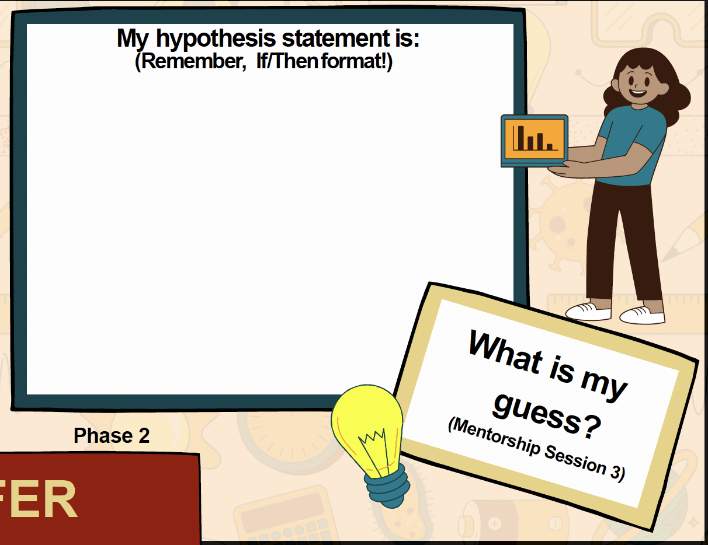
Let’s work through your project map (Phase 2) Open Page 3 of your Workbook

Slide 17
WHAT’S NEXT??
Notes:
Goal: Remind them that next week they will work on their experimental design.

Slide 18
Any Questions? Contact Us Organization Contact: mentorship.fer@gmail.com Organization Website: scienceFER.org
Notes:
Remind them to check the website for more information about the next steps!

